Slide 1
OLIST MONETIZATION ANALYSIS

Slide 2
Monetization Dashboard Link:
https://datastudio.google.com/reporting/f51bf863-c9f8-45fb-9af3-a1a4b90aa19c

Slide 3
General Overview
CUSTOMERS
96K
CUSTOMER CITIES
4K
CUSTOMER STATES
27
ORDERS
99.4K
SELLERS
3K
SELLER CITIES
611
SELLER STATES
23
REVENUE
R$ 16M
AVG REVIEW SCORE
4.01
AVG DELIVERY TIME(DAYS)
12.5

Slide 4
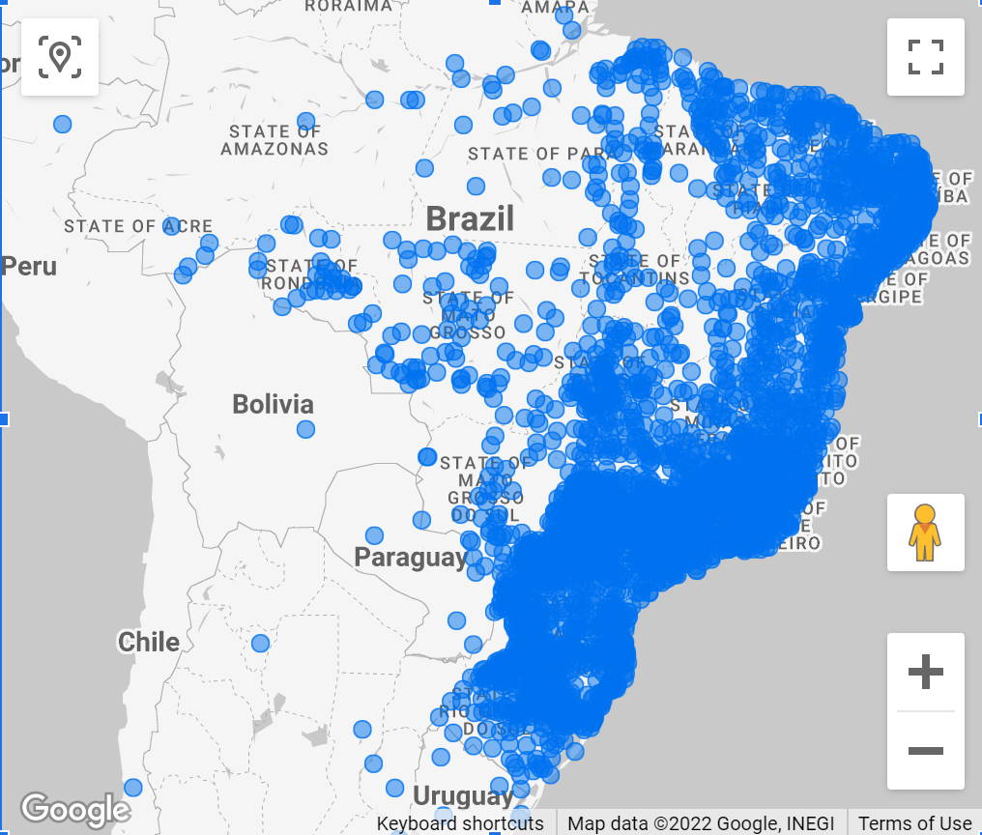
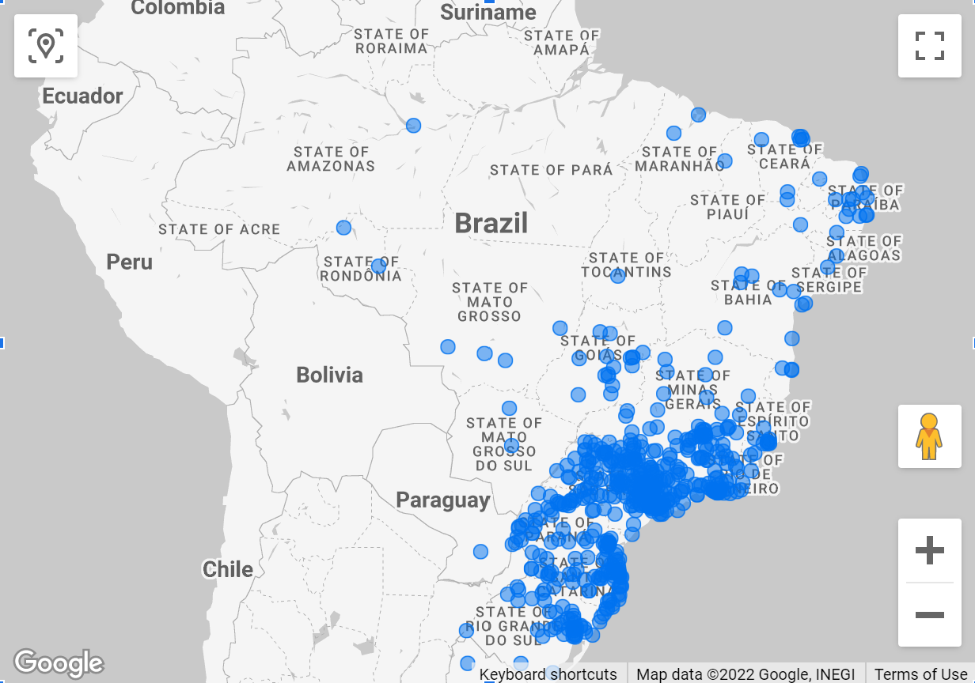
Customers Map – Dense concentration of customers along the coast and in the south, with significantly fewer numbers for the rest of the states.
Sellers Map – Most of the sellers are located in the southern part of the country.

Slide 5
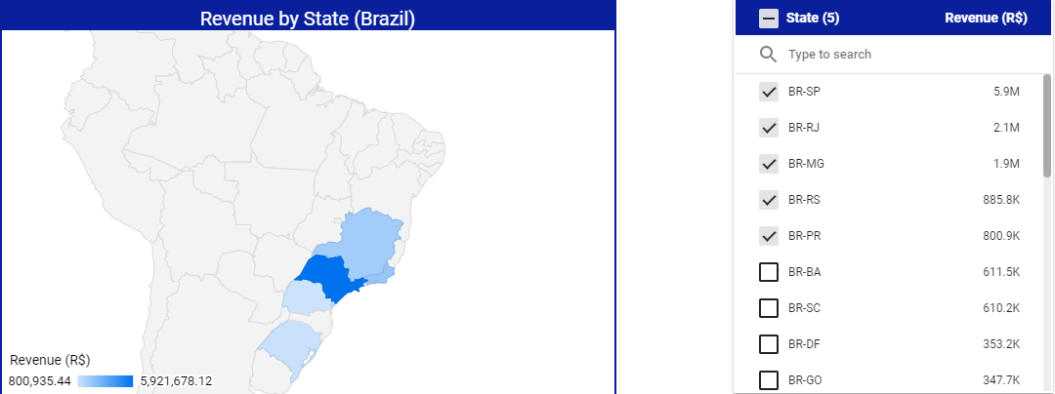
Top 5 States account for R$11.6M out of R$16M, or 73% of all sales.

Slide 6
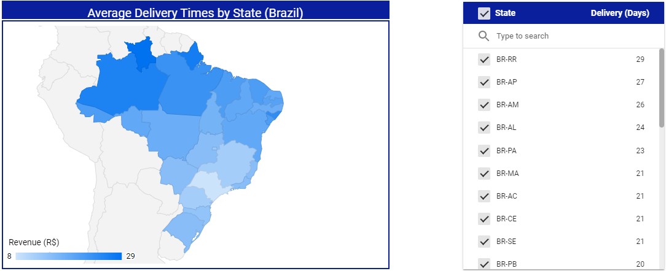
The northern states experience the longest delivery times – 3-4 weeks.

Slide 7
Looking at the delivery times by state we have to concentrate on the states with delivery times above 2 weeks(red). Improved delivery to these states should lead to increased orders and improved customer satisfaction.

Slide 8
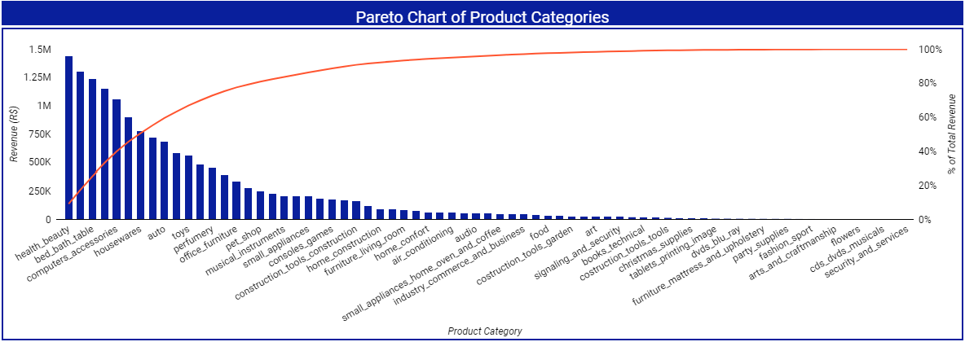
Pareto Chart shows the top 15 product categories (15 out of 71 – 22%) are responsible for 80.9% of all revenue. Efforts to improve customer service(order approval and delivery times) should be taken very seriously since these are the major contributors to overall revenue. Further analysis of the tail end of this chart should also be conducted to determine how to improve sales for these categories and whether it makes sense to continue servicing them at all.

Slide 9
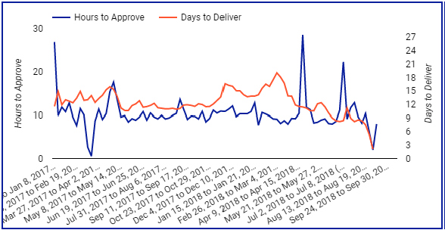
Average time to approve is consistently around 10 hours with very few exceptions. Delivery times vary greatly with delivery locations

Slide 10
Summary
15 out 71 product categories or 22% bring in roughly 81% of all revenue amounting to over 12.5 million. Further analysis needs to be preformed to figure out the reason for success of these products.
Top 5 states account for 72% of all revenue – Efforts should be made to increase sales in northern states.
Delivery times could be improved with new distribution centers as well as by acquiring new sellers in different areas of the country.
17 of 27 states experience delivery times close to 3 weeks. Efforts should be made to improve this metric.
Reducing delivery times below 2 weeks should improve customer satisfaction as well as potentially increase revenue.

